Slide 1
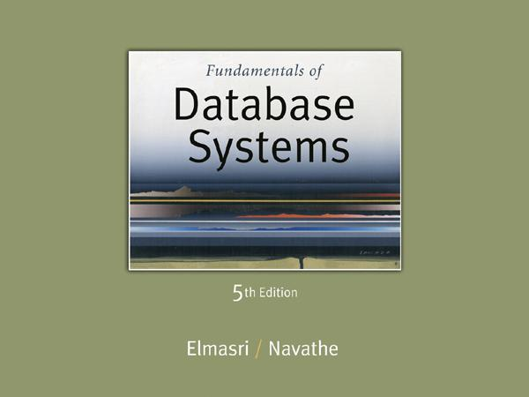
Slide 15- ‹#›
Notes:
‹#›

Slide 2
Chapter 15
Algorithms for Query Processing and Optimization
Copyright © 2007 Ramez Elmasri and Shamkant B. Navathe
Notes:
‹#›

Slide 3
Chapter Outline (1)
0. Introduction to Query Processing
1. Translating SQL Queries into Relational Algebra
2. Algorithms for External Sorting
3. Algorithms for SELECT and JOIN Operations
4. Algorithms for PROJECT and SET Operations
5. Implementing Aggregate Operations and Outer Joins
6. Combining Operations using Pipelining
7. Using Heuristics in Query Optimization
8. Using Selectivity and Cost Estimates in Query Optimization
9. Overview of Query Optimization in Oracle
10. Semantic Query Optimization
Slide 15- ‹#›
Notes:
‹#›

Slide 4
Introduction to Query Processing (3)
Scanner – identifies language tokens- sql keywords,
relation,attributes names
Parser –checks syntax of the query(grammar rules)
Validation- all attributes and relation names are valid and
semantically meaningful names as given in schema
Two internal representations of a query:
Query Tree
Query Graph
Slide 15- ‹#›

Slide 5
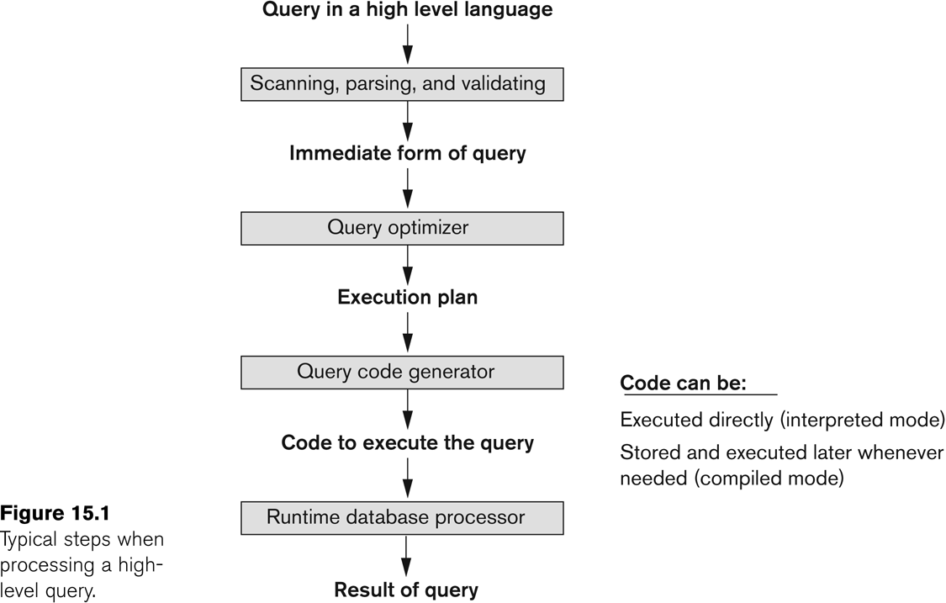
Introduction to Query Processing (2)
Slide 15- ‹#›
Notes:
‹#›

Slide 6
Introduction to Query Processing (1)
Query optimization:
The process of choosing a suitable execution strategy /plan for processing a query.
Query code generator
Generators code to execute the plan
Runtime database processor
runs the query code in compiled/interpreted mode to produce the query result
Slide 15- ‹#›
Notes:
‹#›

Slide 7
Queries are translated into relational algebra queries
and then optimized
Optimization is done in two ways
Heuristic rules and
Systematic estimation(Lowest cost estimate)
Slide 15- ‹#›

Slide 8
1. Translating SQL Queries into Relational Algebra (1)
SQL query is translated into query blocks
Query block:
The basic unit that can be translated into the algebraic operators and optimized.
Slide 15- ‹#›
Notes:
‹#›

Slide 9
Translating SQL Queries into Relational Algebra (1)
A query block contains a single SELECT-FROM-WHERE expression, as well as GROUP BY and HAVING clause if these are part of the block.
Nested queries within a query are identified as separate query blocks.
Aggregate operators in SQL must be included in the extended algebra.
Slide 15- ‹#›

Slide 10
Translating SQL Queries into Relational Algebra (2)
SELECT LNAME, FNAME
FROM EMPLOYEE
WHERE SALARY > ( SELECT MAX (SALARY)
FROM EMPLOYEE
WHERE DNO = 5);
SELECT LNAME, FNAME
FROM EMPLOYEE
WHERE SALARY > C
SELECT MAX (SALARY)
FROM EMPLOYEE
WHERE DNO = 5
π_{LNAME, FNAME} (σ_{SALARY>C}(EMPLOYEE))
ℱ_{MAX SALARY} (σ_{DNO=5} (EMPLOYEE))
Slide 15- ‹#›
Notes:
‹#›

Slide 11
Algorithms for External Sorting
Result should me sorted if the query uses
- order by, join, union, intersection, unique/distinct clause
- Ordering can be avoided if indexing exists
Slide 15- ‹#›

Slide 12
2. Algorithms for External Sorting (1)
External sorting:
Refers to sorting algorithms that are suitable for large files of records stored on disk that do not fit entirely in main memory, such as most database files.
Sort-Merge strategy:
2 phases
Sort phase- sorting small subfiles (runs) of the main file
Merge Phase – Merges the sorted runs, creating larger sorted subfiles that are merged in turn.
Slide 15- ‹#›
Notes:
‹#›

Slide 13
2. Algorithms for External Sorting (1)
Sorting phase:
n_{R}: number of initial runs;
b: number of file blocks of data;
n_{B}: available buffer space in chace;
n_{R} = ⎡(b/n_{B})⎤
Merging phase:
d_{M} = Min (n_{B}-1, n_{R});
n_{P} = ⎡(log_{dM}(n_{R}))⎤
Slide 15- ‹#›
Notes:
‹#›

Slide 14
d_{M}: degree of merging, number of sorted subfiles that can be merged in each merge step;
n_{P}: number of merge passes
Buffer size= block size.
Slide 15- ‹#›

Slide 15
For example,
size of the file b = 1024 blocks,
if nB = 5 blocks
Then find runs, degree of merging
Slide 15- ‹#›

Slide 16
nR = [(b/nB) l , or 205 initial runs each of size 5 blocks (except the last run which will have 4 blocks).
Hence, after the sort phase, 205 sorted runs are stored as temporary subfiles on disk.
Slide 15- ‹#›

Slide 17
-, the sorted runs are merged during one or more passes.
-degree of merging (dM) is the number of runs that can be merged together in each pass.
In each pass,one buffer block is needed to hold one block from each of the runs being merged, and one block is needed for containing one block of the merge result.
, dM = min(5-1, 205) =4
Slide 15- ‹#›

Slide 18
4(four-way merging), so the 205 initial sorted runs would be merged into 52 at the end of the first pass,
which are then merged into 13, then 4, then 1 run, which means that four passes are needed.
The minimum dM of 2 gives the worst-case performance of the algorithm, which is
Slide 15- ‹#›

Slide 19
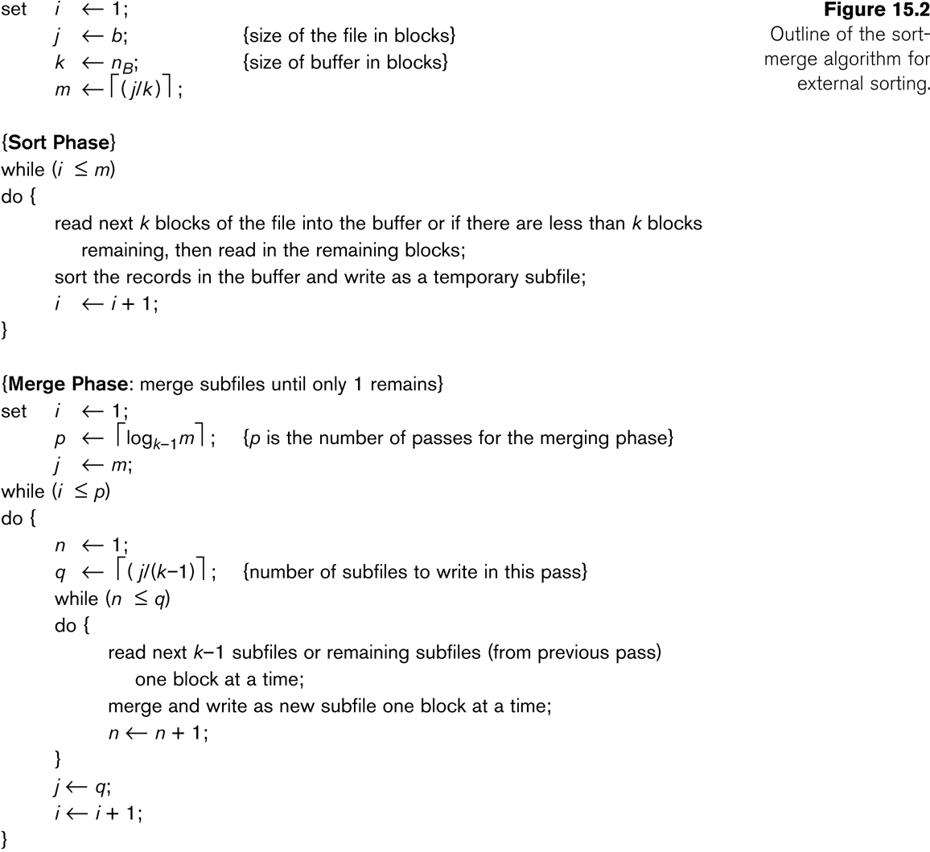
Algorithms for External Sorting (2)
Slide 15- ‹#›
Notes:
‹#›

Slide 20
3. Algorithms for SELECT and JOIN Operations (1)
Implementing the SELECT Operation
Examples:
(OP1): σ _{SSN='123456789'} (EMPLOYEE)
(OP2): σ _{DNUMBER>5}(DEPARTMENT)
(OP3): σ _{DNO=5}(EMPLOYEE)
(OP4): σ DNO=5 AND SALARY>30000 AND SEX=F(EMPLOYEE)
(OP5): σ _{ESSN=123456789 AND PNO=10}(WORKS_ON)
Slide 15- ‹#›
Notes:
‹#›

Slide 21
Algorithms for SELECT and JOIN Operations (2)
Implementing the SELECT Operation (contd.):
Search Methods for Simple Selection:
S1 Linear search (brute force):
Retrieve every record in the file, and test whether its attribute values satisfy the selection condition.
S2 Binary search:
If the selection condition involves an equality comparison on a key attribute on which the file is ordered, binary search (which is more efficient than linear search) can be used. (See OP1).
S3 Using a primary index or hash key to retrieve a single record:
If the selection condition involves an equality comparison on a key attribute with a primary index (or a hash key), use the primary index (or the hash key) to retrieve the record.
Slide 15- ‹#›
Notes:
‹#›

Slide 22
Algorithms for SELECT and JOIN Operations (3)
Implementing the SELECT Operation (contd.):
Search Methods for Simple Selection:
S4 Using a primary index to retrieve multiple records:
If the comparison condition is >, ≥, <, or ≤ on a key field with a primary index, use the index to find the record satisfying the corresponding equality condition, then retrieve all subsequent records in the (ordered) file.
S5 Using a clustering index to retrieve multiple records:
If the selection condition involves an equality comparison on a non-key attribute with a clustering index, use the clustering index to retrieve all the records satisfying the selection condition.
S6 Using a secondary (B+-tree) index:
On an equality comparison, this search method can be used to retrieve a single record if the indexing field has unique values (is a key) or to retrieve multiple records if the indexing field is not a key.
In addition, it can be used to retrieve records on conditions involving >,>=, <, or <=. (FOR RANGE QUERIES)
Slide 15- ‹#›
Notes:
‹#›

Slide 23
Algorithms for SELECT and JOIN Operations (4)
Implementing the SELECT Operation (contd.):
Search Methods for Simple Selection:
S7 Conjunctive selection:
If an attribute involved in any single simple condition in the conjunctive condition has an access path that permits the use of one of the methods S2 to S6, use that condition to retrieve the records and then check whether each retrieved record satisfies the remaining simple conditions in the conjunctive condition.
S8 Conjunctive selection using a composite index
If two or more attributes are involved in equality conditions in the conjunctive condition and a composite index (or hash structure) exists on the combined field, we can use the index directly.
Slide 15- ‹#›
Notes:
‹#›

Slide 24
Algorithms for SELECT and JOIN Operations (5)
Implementing the SELECT Operation (contd.):
Search Methods for Complex Selection:
S9 Conjunctive selection by intersection of record pointers:
This method is possible if secondary indexes are available on all (or some of) the fields involved in equality comparison conditions in the conjunctive condition and if the indexes include record pointers (rather than block pointers).
Each index can be used to retrieve the record pointers that satisfy the individual condition.
The intersection of these sets of record pointers gives the record pointers that satisfy the conjunctive condition, which are then used to retrieve those records directly.
If only some of the conditions have secondary indexes, each retrieved record is further tested to determine whether it satisfies the remaining conditions.
Slide 15- ‹#›
Notes:
‹#›

Slide 25
Algorithms for SELECT and JOIN Operations (7)
Implementing the SELECT Operation (contd.):
Whenever a single condition specifies the selection, we can only check whether an access path exists on the attribute involved in that condition.
If an access path exists, the method corresponding to that access path is used; otherwise, the “brute force” linear search approach of method S1 is used. (See OP1, OP2 and OP3)
For conjunctive selection conditions, whenever more than one of the attributes involved in the conditions have an access path, query optimization should be done to choose the access path that retrieves the fewest records in the most efficient way.
Disjunctive selection conditions
Slide 15- ‹#›
Notes:
‹#›

Slide 26
Algorithms for SELECT and JOIN Operations (8)
Implementing the JOIN Operation:
Join (EQUIJOIN, NATURAL JOIN)
two–way join: a join on two files
e.g. R _{A=B} S
multi-way joins: joins involving more than two files.
e.g. R _{A=B} S _{C=D} T
Examples
(OP6): EMPLOYEE _{DNO=DNUMBER} DEPARTMENT
(OP7): DEPARTMENT _{MGRSSN=SSN} EMPLOYEE
Slide 15- ‹#›
Notes:
‹#›

Slide 27
Algorithms for SELECT and JOIN Operations (9)
Implementing the JOIN Operation (contd.):
Methods for implementing joins:
J1 Nested-loop join (brute force):
For each record t in R (outer loop), retrieve every record s from S (inner loop) and test whether the two records satisfy the join condition t[A] = s[B].
J2 Single-loop join (Using an access structure to retrieve the matching records):
If an index (or hash key) exists for one of the two join attributes — say, B of S — retrieve each record t in R, one at a time, and then use the access structure to retrieve directly all matching records s from S that satisfy s[B] = t[A].
Slide 15- ‹#›
Notes:
‹#›

Slide 28
Algorithms for SELECT and JOIN Operations (10)
Implementing the JOIN Operation (contd.):
Methods for implementing joins:
J3 Sort-merge join:
If the records of R and S are physically sorted (ordered) by value of the join attributes A and B, respectively, we can implement the join in the most efficient way possible.
Both files are scanned in order of the join attributes, matching the records that have the same values for A and B.
In this method, the records of each file are scanned only once each for matching with the other file—unless both A and B are non-key attributes, in which case the method needs to be modified slightly.
Slide 15- ‹#›
Notes:
‹#›

Slide 29
Algorithms for SELECT and JOIN Operations (11)
Implementing the JOIN Operation (contd.):
Methods for implementing joins:
J4 Hash-join:
The records of files R and S are both hashed to the same hash file, using the same hashing function on the join attributes A of R and B of S as hash keys.
A single pass through the file with fewer records (say, R) hashes its records to the hash file buckets.
A single pass through the other file (S) then hashes each of its records to the appropriate bucket, where the record is combined with all matching records from R.
Slide 15- ‹#›
Notes:
‹#›

Slide 30

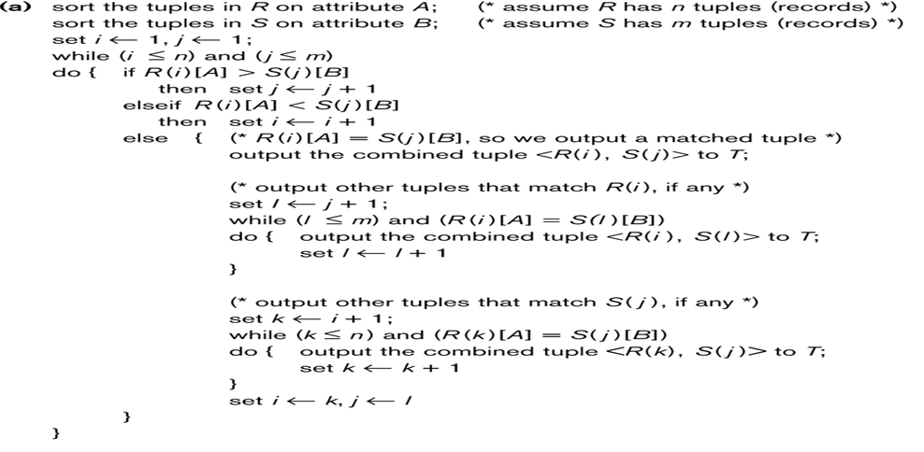
Implementing Join operation-using sort merge
Slide 15- ‹#›

Slide 31
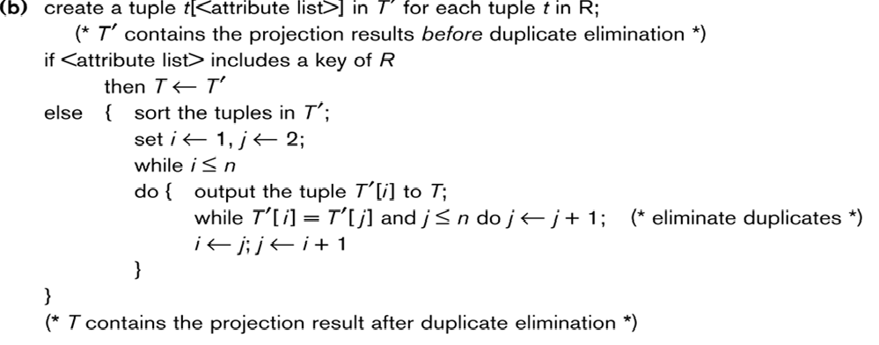
Implementing project operation
Slide 15- ‹#›

Slide 32
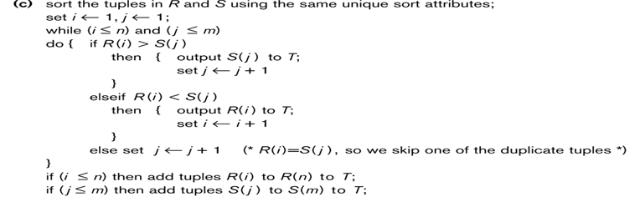
Implementing T<-RUS
Slide 15- ‹#›

Slide 33

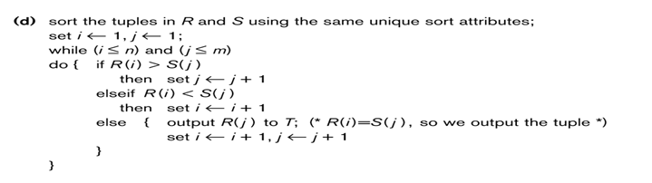
T<- R S
Slide 15- ‹#›

Slide 34
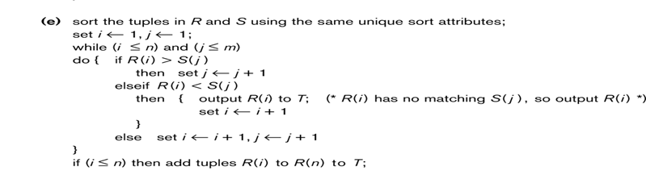
T<- R-S
Slide 15- ‹#›

Slide 35
Algorithms for SELECT and JOIN Operations (14)
Implementing the JOIN Operation (contd.):
Factors affecting JOIN performance
Available buffer space
Join selection factor
Choice of inner VS outer relation
Slide 15- ‹#›
Notes:
‹#›

Slide 36
Algorithms for SELECT and JOIN Operations (15)
Implementing the JOIN Operation (contd.):
Other types of JOIN algorithms
Partition hash join
Partitioning phase:
Each file (R and S) is first partitioned into M partitions using a partitioning hash function on the join attributes:
R1 , R2 , R3 , ...... Rm and S1 , S2 , S3 , ...... Sm
Minimum number of in-memory buffers needed for the partitioning phase: M+1.
A disk sub-file is created per partition to store the tuples for that partition.
Joining or probing phase:
Involves M iterations, one per partitioned file.
Iteration i involves joining partitions Ri and Si.
Slide 15- ‹#›
Notes:
‹#›

Slide 37
Algorithms for SELECT and JOIN Operations (16)
Implementing the JOIN Operation (contd.):
Partitioned Hash Join Procedure:
Assume Ri is smaller than Si.
Copy records from Ri into memory buffers.
Read all blocks from Si, one at a time and each record from Si is used to probe for a matching record(s) from partition Si.
Write matching record from Ri after joining to the record from Si into the result file.
Slide 15- ‹#›
Notes:
‹#›

Slide 38
Algorithms for SELECT and JOIN Operations (17)
Implementing the JOIN Operation (contd.):
Cost analysis of partition hash join:
Reading and writing each record from R and S during the partitioning phase: (b_{R} + b_{S}), (b_{R} + b_{S})
Reading each record during the joining phase: (b_{R} + b_{S})
Writing the result of join: b_{RES}
Total Cost:
3* (b_{R} + b_{S}) + b_{RES}
Slide 15- ‹#›
Notes:
‹#›

Slide 39
Algorithms for SELECT and JOIN Operations (18)
Implementing the JOIN Operation (contd.):
Hybrid hash join:
Same as partitioned hash join except:
Joining phase of one of the partitions is included during the partitioning phase.
Partitioning phase:
Allocate buffers for smaller relation- one block for each of the M-1 partitions, remaining blocks to partition 1.
Repeat for the larger relation in the pass through S.)
Joining phase:
M-1 iterations are needed for the partitions R2 , R3 , R4 , ......Rm and S2 , S3 , S4 , ......Sm. R1 and S1 are joined during the partitioning of S1, and results of joining R1 and S1 are already written to the disk by the end of partitioning phase.
Slide 15- ‹#›
Notes:
‹#›

Slide 40
4. Algorithms for PROJECT and SET Operations (1)
Algorithm for PROJECT operations (Figure 15.3b)
π _{<attribute list>}(R)
If <attribute list> has a key of relation R, extract all tuples from R with only the values for the attributes in <attribute list>.
If <attribute list> does NOT include a key of relation R, duplicated tuples must be removed from the results.
Methods to remove duplicate tuples
Sorting
Hashing
Slide 15- ‹#›
Notes:
‹#›

Slide 41
Algorithms for PROJECT and SET Operations (2)
Algorithm for SET operations
Set operations:
UNION, INTERSECTION, SET DIFFERENCE and CARTESIAN PRODUCT
CARTESIAN PRODUCT of relations R and S include all possible combinations of records from R and S. The attribute of the result include all attributes of R and S.
Cost analysis of CARTESIAN PRODUCT
If R has n records and j attributes and S has m records and k attributes, the result relation will have n*m records and j+k attributes.
CARTESIAN PRODUCT operation is very expensive and should be avoided if possible.
Slide 15- ‹#›
Notes:
‹#›

Slide 42
Algorithms for PROJECT and SET Operations (3)
Algorithm for SET operations (contd.)
UNION (See Figure 15.3c)
Sort the two relations on the same attributes.
Scan and merge both sorted files concurrently, whenever the same tuple exists in both relations, only one is kept in the merged results.
INTERSECTION (See Figure 15.3d)
Sort the two relations on the same attributes.
Scan and merge both sorted files concurrently, keep in the merged results only those tuples that appear in both relations.
SET DIFFERENCE R-S (See Figure 15.3e)
Keep in the merged results only those tuples that appear in relation R but not in relation S.
Slide 15- ‹#›
Notes:
‹#›

Slide 43
5. Implementing Aggregate Operations and Outer Joins (1)
Implementing Aggregate Operations:
Aggregate operators:
MIN, MAX, SUM, COUNT and AVG
Options to implement aggregate operators:
Table Scan
Index
Example
SELECT MAX (SALARY)
FROM EMPLOYEE;
If an (ascending) index on SALARY exists for the employee relation, then the optimizer could decide on traversing the index for the largest value, which would entail following the right most pointer in each index node from the root to a leaf.
Slide 15- ‹#›
Notes:
‹#›

Slide 44
Implementing Aggregate Operations and Outer Joins (2)
Implementing Aggregate Operations (contd.):
SUM, COUNT and AVG
For a dense index (each record has one index entry):
Apply the associated computation to the values in the index.
For a non-dense index:
Actual number of records associated with each index entry must be accounted for
With GROUP BY: the aggregate operator must be applied separately to each group of tuples.
Use sorting or hashing on the group attributes to partition the file into the appropriate groups;
Computes the aggregate function for the tuples in each group.
Slide 15- ‹#›
Notes:
‹#›

Slide 45
Implementing Aggregate Operations and Outer Joins (3)
Implementing Outer Join:
Outer Join Operators:
LEFT OUTER JOIN
RIGHT OUTER JOIN
FULL OUTER JOIN.
The full outer join produces a result which is equivalent to the union of the results of the left and right outer joins.
Example:
SELECT FNAME, DNAME
FROM (EMPLOYEE LEFT OUTER JOIN DEPARTMENT
ON DNO = DNUMBER);
Note: The result of this query is a table of employee names and their associated departments. It is similar to a regular join result, with the exception that if an employee does not have an associated department, the employee's name will still appear in the resulting table, although the department name would be indicated as null.
Slide 15- ‹#›
Notes:
‹#›

Slide 46
Implementing Aggregate Operations and Outer Joins (4)
Implementing Outer Join (contd.):
Modifying Join Algorithms:
Nested Loop or Sort-Merge joins can be modified to implement outer join. E.g.,
For left outer join, use the left relation as outer relation and construct result from every tuple in the left relation.
If there is a match, the concatenated tuple is saved in the result.
However, if an outer tuple does not match, then the tuple is still included in the result but is padded with a null value(s).
Slide 15- ‹#›
Notes:
‹#›

Slide 47
Implementing Aggregate Operations and Outer Joins (5)
Implementing Outer Join (contd.):
Executing a combination of relational algebra operators.
Implement the previous left outer join example
{Compute the JOIN of the EMPLOYEE and DEPARTMENT tables}
TEMP1←π_{FNAME,DNAME}(EMPLOYEE _{DNO=DNUMBER} DEPARTMENT)
{Find the EMPLOYEEs that do not appear in the JOIN}
TEMP2 ← π _{FNAME} (EMPLOYEE) - π_{FNAME} (Temp1)
{Pad each tuple in TEMP2 with a null DNAME field}
TEMP2 ← TEMP2 x 'null'
{UNION the temporary tables to produce the LEFT OUTER JOIN}
RESULT ← TEMP1 υ TEMP2
The cost of the outer join, as computed above, would include the cost of the associated steps (i.e., join, projections and union).
Slide 15- ‹#›
Notes:
‹#›

Slide 48
6. Combining Operations using Pipelining (1)
Motivation
A query is mapped into a sequence of operations.
Each execution of an operation produces a temporary result.
Generating and saving temporary files on disk is time consuming and expensive.
Alternative:
Avoid constructing temporary results as much as possible.
Pipeline the data through multiple operations - pass the result of a previous operator to the next without waiting to complete the previous operation.
Slide 15- ‹#›
Notes:
‹#›

Slide 49
Combining Operations using Pipelining (2)
Example:
For a 2-way join, combine the 2 selections on the input and one projection on the output with the Join.
Dynamic generation of code to allow for multiple operations to be pipelined.
Results of a select operation are fed in a "Pipeline" to the join algorithm.
Also known as stream-based processing.
Slide 15- ‹#›
Notes:
‹#›

Slide 50
7. Using Heuristics in Query Optimization(1)
Process for heuristics optimization
The parser of a high-level query generates an initial internal representation;
Apply heuristics rules to optimize the internal representation.
A query execution plan is generated to execute groups of operations based on the access paths available on the files involved in the query.
The main heuristic is to apply first the operations that reduce the size of intermediate results.
E.g., Apply SELECT and PROJECT operations before applying the JOIN or other binary operations.
Slide 15- ‹#›
Notes:
‹#›

Slide 51
Using Heuristics in Query Optimization (2)
Query tree:
A tree data structure that corresponds to a relational algebra expression. It represents the input relations of the query as leaf nodes of the tree, and represents the relational algebra operations as internal nodes.
An execution of the query tree consists of executing an internal node operation whenever its operands are available and then replacing that internal node by the relation that results from executing the operation.
Query graph:
A graph data structure that corresponds to a relational calculus expression. It does not indicate an order on which operations to perform first. There is only a single graph corresponding to each query.
Slide 15- ‹#›
Notes:
‹#›

Slide 52
Emp-
( FNAME, LNAME, SSN, BDATE, ADDRESS,CITY, SUPERVISOR-SSN)
DEPT
-(DNAME, DNUMBER, MGR-SSN, START-DATE)
WORKS- ON(ESSN,PNO,HOURS)
PROJECT
(PNAME, PNUMBER,PLOCATION,DNUM)
Slide 15- ‹#›

Slide 53
Using Heuristics in Query Optimization (3)
Example:
For every project located in ‘Stafford’, retrieve the project number, the controlling department number and the department manager’s last name, address and birthdate.
SQL query:
Q2: SELECT P.NUMBER,P.DNUM,E.LNAME, E.ADDRESS, E.BDATE
FROM PROJECT AS P,DEPARTMENT AS D, EMPLOYEE AS E
WHERE P.DNUM=D.DNUMBER AND D.MGRSSN=E.SSN AND
P.PLOCATION=‘STAFFORD’;
Slide 15- ‹#›
Notes:
‹#›

Slide 54
Slide 15- ‹#›

Slide 55
Relation algebra:
PNUMBER, DNUM, LNAME, ADDRESS, BDATE
(((_{PLOCATION=‘STAFFORD’}(PROJECT))
_{DNUM=DNUMBER} (DEPARTMENT)) _{MGRSSN=SSN} (EMPLOYEE))
Slide 15- ‹#›

Slide 56
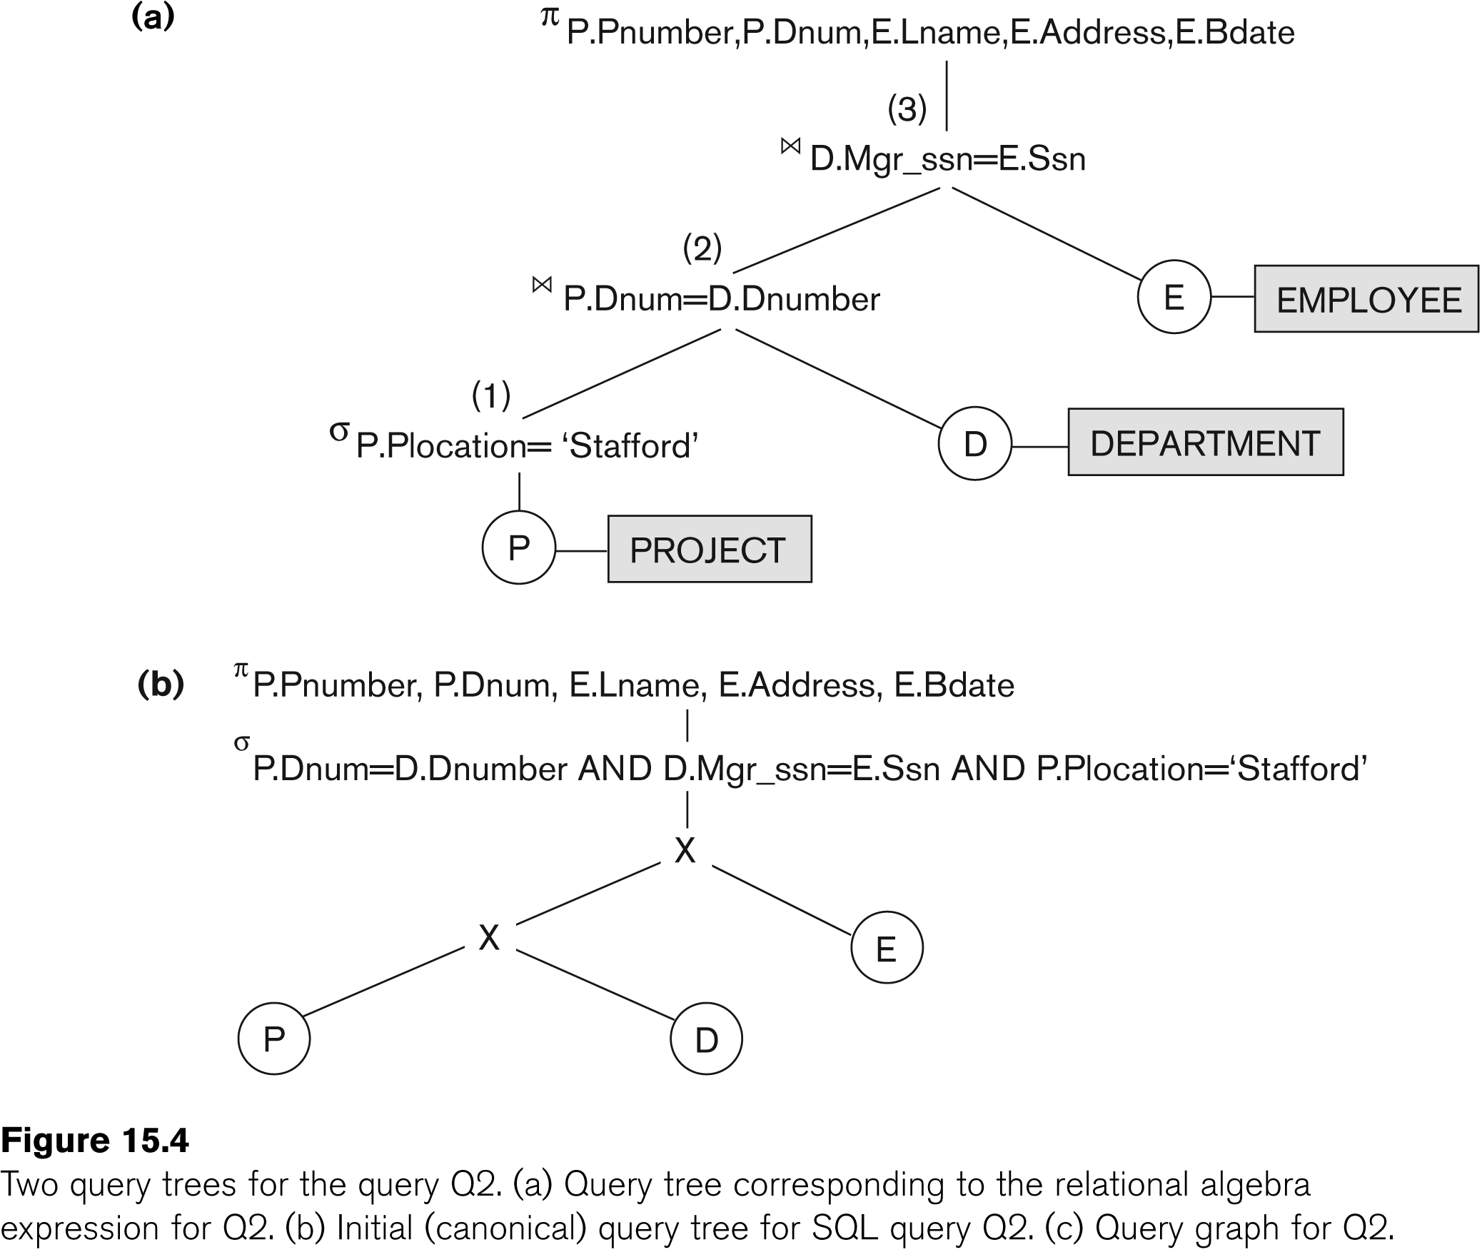
Using Heuristics in Query Optimization (4)
Slide 15- ‹#›
Notes:
‹#›

Slide 57
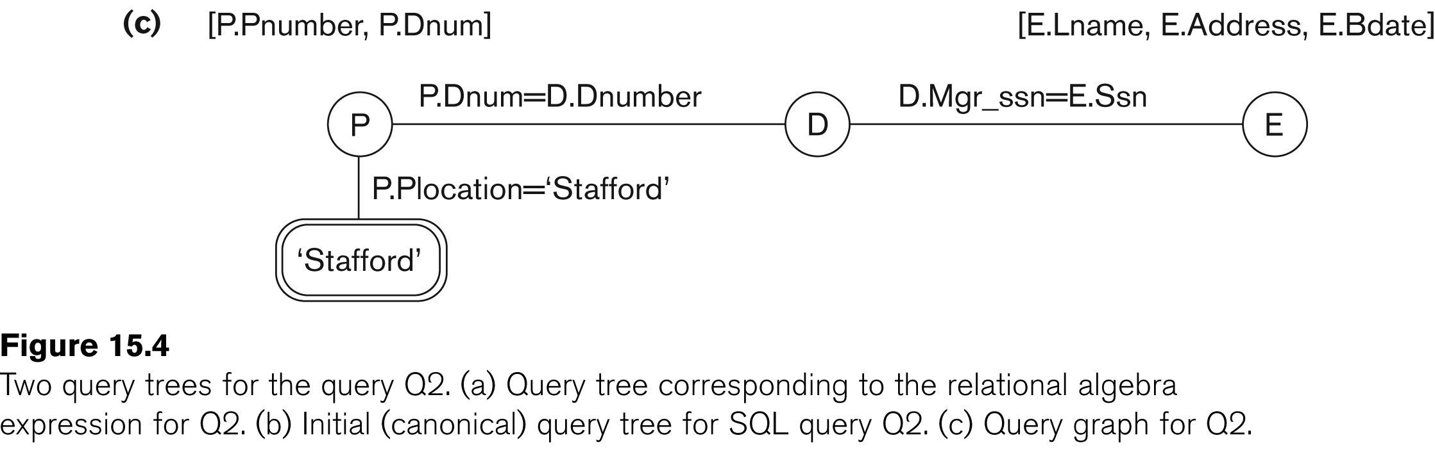
Using Heuristics in Query Optimization (5)
Slide 15- ‹#›
Notes:
‹#›

Slide 58
Using Heuristics in Query Optimization (6)
Heuristic Optimization of Query Trees:
The same query could correspond to many different relational algebra expressions — and hence many different query trees.
The task of heuristic optimization of query trees is to find a final query tree that is efficient to execute.
Example: Find the last name of employees working on project ‘AQUARIUS ‘ and born after 1957-12-31
Slide 15- ‹#›
Notes:
‹#›

Slide 59
Using Heuristics in Query Optimization (6)
Heuristic Optimization of Query Trees:
Example:
Q: SELECT LNAME
FROM EMPLOYEE, WORKS_ON, PROJECT
WHERE PNAME = ‘AQUARIUS’ AND
PNMUBER=PNO AND ESSN=SSN
AND BDATE > ‘1957-12-31’;
Slide 15- ‹#›
Notes:
‹#›

Slide 60
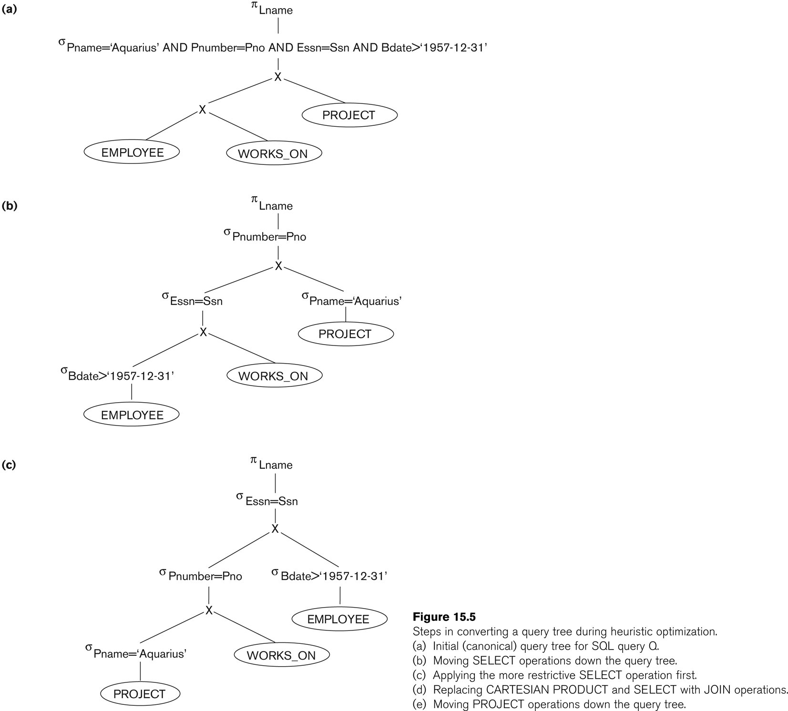
Using Heuristics in Query Optimization (7)
Slide 15- ‹#›
Notes:
‹#›

Slide 61
Using Heuristics in Query Optimization (7)
Slide 15- ‹#›
Notes:
‹#›

Slide 62
Using Heuristics in Query Optimization (7)
Slide 15- ‹#›
Notes:
‹#›

Slide 63
Using Heuristics in Query Optimization (7)
Slide 15- ‹#›
Notes:
‹#›

Slide 64
Slide 15- ‹#›

Slide 65
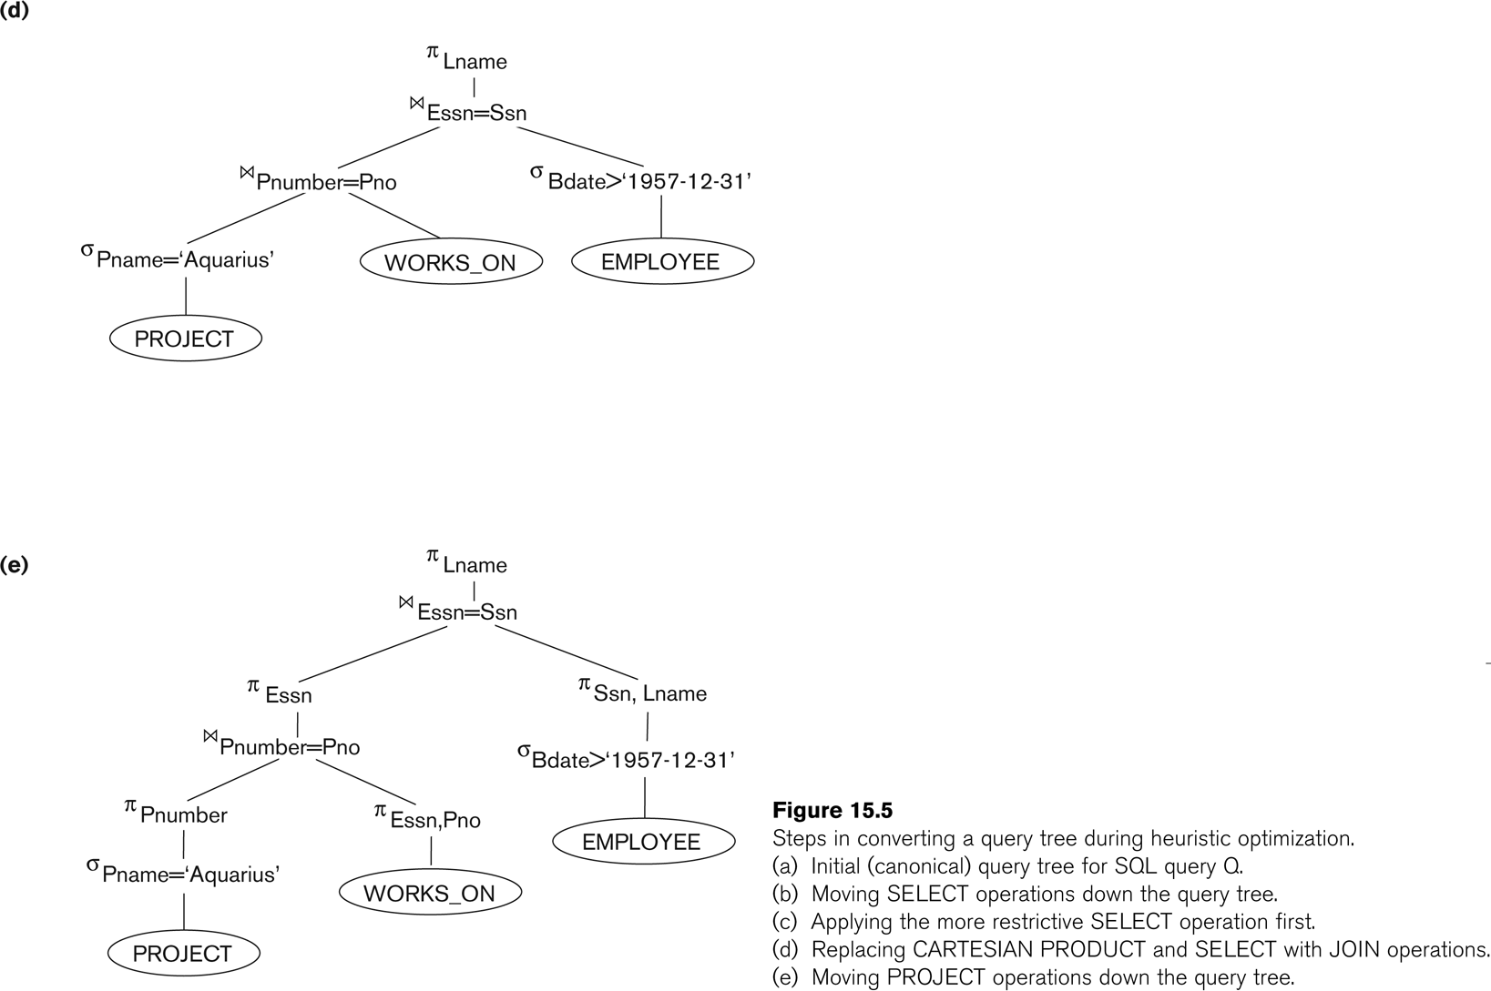
Using Heuristics in Query Optimization (8)
Slide 15- ‹#›
Notes:
‹#›

Slide 66
Using Heuristics in Query Optimization (9)
General Transformation Rules for Relational Algebra Operations:
1. Cascade of σ: A conjunctive selection condition can be broken up into a cascade (sequence) of individual σ operations:
σ _{c1 AND c2 AND ... AND cn}(R) = σ_{c1} (σ_{c2} (...(σ_{cn}(R))...) )
2. Commutativity of σ: The σ operation is commutative:
σ_{c1} (σ_{c2}(R)) = σ_{c2} (σ_{c1}(R))
3. Cascade of π: In a cascade (sequence) of π operations, all but the last one can be ignored:
π_{List1} (π_{List2} (...(π_{Listn}(R))...) ) = π_{List1}(R)
4. Commuting σ with π: If the selection condition c involves only the attributes A1, ..., An in the projection list, the two operations can be commuted:
π_{A1, A2, ..., An} (σ_{c} (R)) = σ_{c} (π_{A1, A2, ..., An} (R))
Slide 15- ‹#›
Notes:
‹#›

Slide 67
Using Heuristics in Query Optimization (10)
General Transformation Rules for Relational Algebra Operations (contd.):
5. Commutativity of ( and x ): The operation is commutative as is the x operation:
R _{C} S = S _{C} R; R x S = S x R
6. Commuting σ with (or x ): If all the attributes in the selection condition c involve only the attributes of one of the relations being joined—say, R—the two operations can be commuted as follows:
σ_{c} ( R S ) = (σ_{c} (R)) S
Alternatively, if the selection condition c can be written as (c1 and c2), where condition c1 involves only the attributes of R and condition c2 involves only the attributes of S, the operations commute as follows:
σ_{c} ( R S ) = (σ_{c1} (R)) (σ_{c2} (S))
Slide 15- ‹#›
Notes:
‹#›

Slide 68
Using Heuristics in Query Optimization (11)
General Transformation Rules for Relational Algebra Operations (contd.):
7. Commuting π with (or x): Suppose that the projection list is L = {A1, ..., An, B1, ..., Bm}, where A1, ..., An are attributes of R and B1, ..., Bm are attributes of S. If the join condition c involves only attributes in L, the two operations can be commuted as follows:
π_{L} ( R _{C} S ) = (π_{A1, ..., An} (R)) _{C} (π _{B1, ..., Bm} (S))
If the join condition C contains additional attributes not in L, these must be added to the projection list, and a final π operation is needed.
Slide 15- ‹#›
Notes:
‹#›

Slide 69
Using Heuristics in Query Optimization (12)
General Transformation Rules for Relational Algebra Operations (contd.):
8. Commutativity of set operations: The set operations υ and ∩ are commutative but “–” is not.
9. Associativity of , x, υ, and ∩ : These four operations are individually associative; that is, if θ stands for any one of these four operations (throughout the expression), we have
( R θ S ) θ T = R θ ( S θ T )
10. Commuting σ with set operations: The σ operation commutes with υ , ∩ , and –. If θ stands for any one of these three operations, we have
σ_{c} ( R θ S ) = (σ_{c} (R)) θ (σ_{c} (S))
Slide 15- ‹#›
Notes:
‹#›

Slide 70
Using Heuristics in Query Optimization (13)
General Transformation Rules for Relational Algebra Operations (contd.):
The π operation commutes with υ. π_{L} ( R υ S ) = (π_{L} (R)) υ (π_{L} (S))
Converting a (σ, x) sequence into : If the condition c of a σ that follows a x Corresponds to a join condition, convert the (σ, x) sequence into a as follows: (σ_{C} (R x S)) = (R _{C} S)
Other transformations
Slide 15- ‹#›
Notes:
‹#›

Slide 71
Using Heuristics in Query Optimization (14)
Outline of a Heuristic Algebraic Optimization Algorithm:
Using rule 1, break up any select operations with conjunctive conditions into a cascade of select operations.
Using rules 2, 4, 6, and 10 concerning the commutativity of select with other operations, move each select operation as far down the query tree as is permitted by the attributes involved in the select condition.
Using rule 9 concerning associativity of binary operations, rearrange the leaf nodes of the tree so that the leaf node relations with the most restrictive select operations are executed first in the query tree representation.
Using Rule 12, combine a Cartesian product operation with a subsequent select operation in the tree into a join operation.
Using rules 3, 4, 7, and 11 concerning the cascading of project and the commuting of project with other operations, break down and move lists of projection attributes down the tree as far as possible by creating new project operations as needed.
Identify subtrees that represent groups of operations that can be executed by a single algorithm.
Slide 15- ‹#›
Notes:
‹#›

Slide 72
Using Heuristics in Query Optimization (15)
Summary of Heuristics for Algebraic Optimization:
The main heuristic is to apply first the operations that reduce the size of intermediate results.
Perform select operations as early as possible to reduce the number of tuples and perform project operations as early as possible to reduce the number of attributes. (This is done by moving select and project operations as far down the tree as possible.)
The select and join operations that are most restrictive should be executed before other similar operations. (This is done by reordering the leaf nodes of the tree among themselves and adjusting the rest of the tree appropriately.)
Slide 15- ‹#›
Notes:
‹#›

Slide 73
Using Heuristics in Query Optimization (16)
Query Execution Plans
An execution plan for a relational algebra query consists of a combination of the relational algebra query tree and information about the access methods to be used for each relation as well as the methods to be used in computing the relational operators stored in the tree.
Materialized evaluation: the result of an operation is stored as a temporary relation.
Pipelined evaluation: as the result of an operator is produced, it is forwarded to the next operator in sequence.
Slide 15- ‹#›
Notes:
‹#›

Slide 74
8. Using Selectivity and Cost Estimates in Query Optimization (1)
Cost-based query optimization:
Estimate and compare the costs of executing a query using different execution strategies and choose the strategy with the lowest cost estimate.
(Compare to heuristic query optimization)
Issues
Cost function
Number of execution strategies to be considered
Slide 15- ‹#›
Notes:
‹#›

Slide 75
Using Selectivity and Cost Estimates in Query Optimization (2)
Cost Components for Query Execution
Access cost to secondary storage
Storage cost
Computation cost
Memory usage cost
Communication cost
Note: Different database systems may focus on different cost components.
Slide 15- ‹#›
Notes:
‹#›

Slide 76
Using Selectivity and Cost Estimates in Query Optimization (3)
Catalog Information Used in Cost Functions
Information about the size of a file
number of records (tuples) (r),
record size (R),
number of blocks (b)
blocking factor (bfr)
Information about indexes and indexing attributes of a file
Number of levels (x) of each multilevel index
Number of first-level index blocks (bI1)
Number of distinct values (d) of an attribute
Selectivity (sl) of an attribute is the fraction of records satisfying the equality condition on the attribute
Selection cardinality (s) of an attribute. (s = sl * r)
Slide 15- ‹#›
Notes:
‹#›

Slide 77
Using Selectivity and Cost Estimates in Query Optimization (4)
Examples of Cost Functions for SELECT
S1. Linear search (brute force) approach
C_{S1a} = b;
For an equality condition on a key, C_{S1a} = (b/2) if the record is found; otherwise C_{S1a} = b.
S2. Binary search:
C_{S2} = log₂b + (s/bfr)⎤ –1
For an equality condition on a unique (key) attribute, C_{S2} =log₂b
S3. Using a primary index (S3a) or hash key (S3b) to retrieve a single record
C_{S3a} = x + 1; C_{S3b} = 1 for static or linear hashing;
C_{S3b} = 1 for extendible hashing;
number
Slide 15- ‹#›
Notes:
‹#›

Slide 78
Using Selectivity and Cost Estimates in Query Optimization (5)
Examples of Cost Functions for SELECT (contd.)
S4. Using an ordering index to retrieve multiple records:
For the comparison condition on a key field with an ordering index, C_{S4} = x + (b/2)
S5. Using a clustering index to retrieve multiple records:
C_{S5} = x + ┌ (s/bfr) ┐
S6. Using a secondary (B+-tree) index:
For an equality comparison, C_{S6a} = x + s;
For an comparison condition such as >, <, >=, or <=,
C_{S6a} = x + (b_{I1}/2) + (r/2)
Slide 15- ‹#›
Notes:
‹#›

Slide 79
Using Selectivity and Cost Estimates in Query Optimization (6)
Examples of Cost Functions for SELECT (contd.)
S7. Conjunctive selection:
Use either S1 or one of the methods S2 to S6 to solve.
For the latter case, use one condition to retrieve the records and then check in the memory buffer whether each retrieved record satisfies the remaining conditions in the conjunction.
S8. Conjunctive selection using a composite index:
Same as S3a, S5 or S6a, depending on the type of index.
Examples of using the cost functions.
Slide 15- ‹#›
Notes:
‹#›

Slide 80
Using Selectivity and Cost Estimates in Query Optimization (7)
Examples of Cost Functions for JOIN
Join selectivity (js)
js = | (R _{C} S) | / | R x S | = | (R _{C} S) | / (|R| * |S |)
If condition C does not exist, js = 1;
If no tuples from the relations satisfy condition C, js = 0;
Usually, 0 <= js <= 1;
Size of the result file after join operation
| (R _{C} S) | = js * |R| * |S |
Slide 15- ‹#›
Notes:
‹#›

Slide 81
Using Selectivity and Cost Estimates in Query Optimization (8)
Examples of Cost Functions for JOIN (contd.)
J1. Nested-loop join:
C_{J1} = b_{R} + (b_{R}*b_{S}) + ((js* |R|* |S|)/bfr_{RS})
(Use R for outer loop)
J2. Single-loop join (using an access structure to retrieve the matching record(s))
If an index exists for the join attribute B of S with index levels x_{B}, we can retrieve each record s in R and then use the index to retrieve all the matching records t from S that satisfy t[B] = s[A].
The cost depends on the type of index.
Slide 15- ‹#›
Notes:
‹#›

Slide 82
Using Selectivity and Cost Estimates in Query Optimization (9)
Examples of Cost Functions for JOIN (contd.)
J2. Single-loop join (contd.)
For a secondary index,
C_{J2a} = b_{R} + (|R| * (x_{B} + s_{B})) + ((js* |R|* |S|)/bfr_{RS});
For a clustering index,
C_{J2b} = b_{R} + (|R| * (x_{B} + (s_{B}/bfr_{B}))) + ((js* |R|* |S|)/bfr_{RS});
For a primary index,
C_{J2c} = b_{R} + (|R| * (x_{B} + 1)) + ((js* |R|* |S|)/bfr_{RS});
If a hash key exists for one of the two join attributes — B of S
C_{J2d} = b_{R} + (|R| * h) + ((js* |R|* |S|)/bfr_{RS});
J3. Sort-merge join:
C_{J3a} = C_{S} + b_{R} + b_{S} + ((js* |R|* |S|)/bfr_{RS});
(CS: Cost for sorting files)
Slide 15- ‹#›
Notes:
‹#›

Slide 83
Using Selectivity and Cost Estimates in Query Optimization (10)
Multiple Relation Queries and Join Ordering
A query joining n relations will have n-1 join operations, and hence can have a large number of different join orders when we apply the algebraic transformation rules.
Current query optimizers typically limit the structure of a (join) query tree to that of left-deep (or right-deep) trees.
Left-deep tree:
A binary tree where the right child of each non-leaf node is always a base relation.
Amenable to pipelining
Could utilize any access paths on the base relation (the right child) when executing the join.
Slide 15- ‹#›
Notes:
‹#›

Slide 84
9. Overview of Query Optimization in Oracle
Oracle DBMS V8
Rule-based query optimization: the optimizer chooses execution plans based on heuristically ranked operations.
(Currently it is being phased out)
Cost-based query optimization: the optimizer examines alternative access paths and operator algorithms and chooses the execution plan with lowest estimate cost.
The query cost is calculated based on the estimated usage of resources such as I/O, CPU and memory needed.
Application developers could specify hints to the ORACLE query optimizer.
The idea is that an application developer might know more information about the data.
Slide 15- ‹#›
Notes:
‹#›

Slide 85
10. Semantic Query Optimization
Semantic Query Optimization:
Uses constraints specified on the database schema in order to modify one query into another query that is more efficient to execute.
Consider the following SQL query,
SELECT E.LNAME, M.LNAME
FROM EMPLOYEE E M
WHERE E.SUPERSSN=M.SSN AND E.SALARY>M.SALARY
Explanation:
Suppose that we had a constraint on the database schema that stated that no employee can earn more than his or her direct supervisor. If the semantic query optimizer checks for the existence of this constraint, it need not execute the query at all because it knows that the result of the query will be empty. Techniques known as theorem proving can be used for this purpose.
Slide 15- ‹#›
Notes:
‹#›

Slide 86
Summary
0. Introduction to Query Processing
1. Translating SQL Queries into Relational Algebra
2. Algorithms for External Sorting
3. Algorithms for SELECT and JOIN Operations
4. Algorithms for PROJECT and SET Operations
5. Implementing Aggregate Operations and Outer Joins
6. Combining Operations using Pipelining
7. Using Heuristics in Query Optimization
8. Using Selectivity and Cost Estimates in Query Optimization
9. Overview of Query Optimization in Oracle
10. Semantic Query Optimization
Slide 15- ‹#›
Notes:
‹#›

